Slide 1
Landside embankments – grass/floral seed mix 1/2
We will be creating a diverse and vibrant ecosystem using appropriate seed mixes, in the areas of embankment that require seeding.
What does the seed mix contain?
Each area will have a different make-up of seed mix depending on the area that required coverage. However, the seed mix will contain a combination of the following grasses and Seed mix. This mix was chosen for their resilience to local climatic conditions and ability to thrive in the specific soil composition.
Wildflowers Grasses
Species | Common Name
Galium Verum | Ladys Bedstraw
Leontodon Hispidus | Rough Hawkbit
Leucanthemum Vulgar | Ox-eye Daisy
Lotus Corniculatus | Birds-foot Trefoil
Primula Veris | Cowslip
Prunella Vulgaris | Selfheal
Ranunculus Acris | Meadow Buttercup
Trifolium Pratense | Red Clover
Species | Common Name
Agrostis Capillaries | Common Bent
Cynosurus Cristatus | Crested Dogs-Tail
Festuca Rubra Rubra | Strong Creeping Red Fescue
Phleum Bertoloni | Smaller Cat's Tail

Slide 2
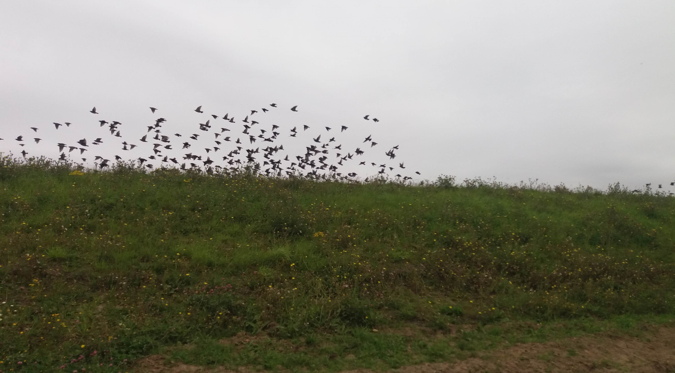
Reinstated embankment 2/2
How long does it take for the grass/seed mix to grow?
As part of the reinstatement of landside embankments we are aiming to promote a biodiverse and stable landscape. The use of seed mixes tailored to the local environment is essential in this process. These mixes will include a variety of grasses and wildflowers that are native to the area, which not only help to prevent soil erosion but also provide a habitat for local wildlife. The selection of species like Agrostis Capillaris (common bent) and Cynosurus Cristatus (crested dog's tail) for grass coverage, coupled with wildflowers such as Galium verum (lady's bedstraw), are key to achieving this. We have chosen them for their resilience to local climatic conditions and ability to thrive in the specific soil composition.
How long does it take for the grass/seed
mix to grow?
The full growth of the grass on the embankment reinstatement will not be
visible until a few seasons past or visible once we hand the project back
and will require ongoing care and attention. Maintenance will include
monitoring growth, managing weeds, and ensuring soil health.
The reintroduction of the original topsoil to the revetment will be
particularly beneficial as it contains indigenous seed banks and
microorganisms that are crucial for plant growth. Over time, we
anticipate the embankments to develop into a self-sustaining
ecosystem that not only supports wildlife but also enhances
the natural beauty of the area will occur.
An embankment that has received diligent care and maintenance over multiple seasons.

